Slide 1
Case Study
Ransomware Attack
Company: MGM Resorts, a Casino in Las Vegas
Affected Properties: Bellagio, Cosmopolitan and Mandalay Bay and other MGM Resorts across the U.S.

Slide 2
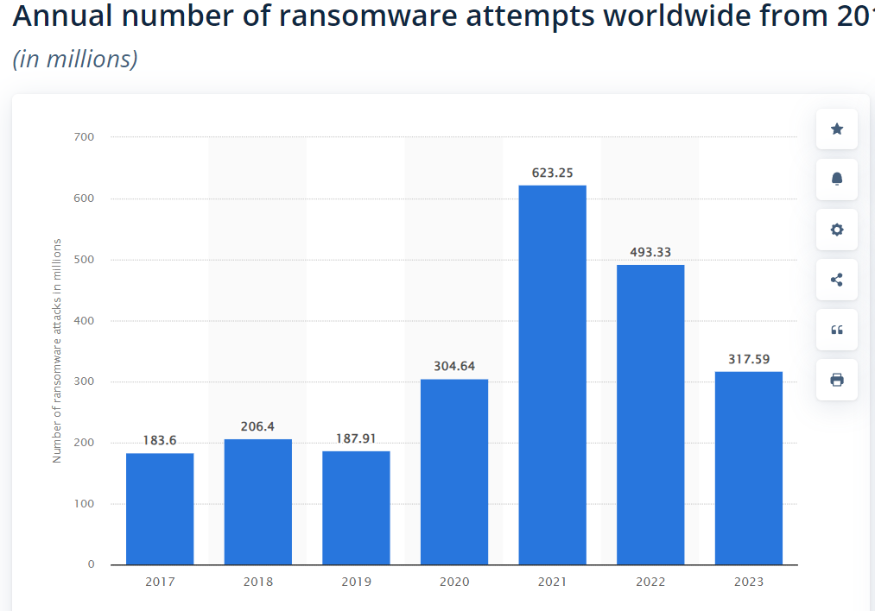
Ransomware
1. Attack type description: deceive employees over the phone into divulging login information (vishing), use of social engineering to gain access to network systems, and then moved within the systems and install ransomware.
2. Ransomware attack from 2017 to 2023 has seen a significant decrease in 2023. World wide organization has detected 317.59 ransomware attempts in 2023.
Sources:
https://cybernews.com/news/mgm-touts-cyber-attack-recovery-on-track-employees-tell-different-story/
https://inszoneinsurance.com/blog/cyberattack-mgm-resort-explained#:~:text=The%20attack%20affected%20some%20of,payment%20systems%20and%20online%20reservations.
https://westoahu.hawaii.edu/cyber/global-weekly-exec-summary/alphv-hackers-reveal-details-of-mgm-cyber-attack/#:~:text=In%20September%202023%2C%20MGM%20Resorts,resulted%20in%20a%20ransomware%20attack.
https://www.statista.com/statistics/494947/ransomware-attempts-per-year-worldwide/
https://www.nbcnews.com/business/business-news/cyberattack-cost-mgm-resorts-100-million-las-vegas-company-says-rcna119138
https://www.404media.co/inside-mgms-hacked-casinos/
https://www.sec.gov/ix?doc=/Archives/edgar/data/789570/000119312523251667/d461062d8k.htm
Attack Category:
Ransomware

Slide 3
company description and breach summary
MGM is a prominent Casino located in Las Vegas on the Las Vegas Strip. MGM experience a breach in September 2023 at that same time Caesar also got hacked, but Caesar, MGM competitor, quickly paid $15 million in ransom to continue operating without any interruptions.
MGM was breached by APHV and Scatter Spider, the attack lasted 10 days in September 2023. APHV was able to use social engineering “vishing” to trick employees into revealing sensitive login information. The hackers was able to use this login information to gain access to the company’s system.
At first contact by APHV letting MGM be aware that they have been hacked and the ransom ware is in place. MGM refused to pay the ransom instead MGM shut down their system, this caused a lot of problems equipment stopped functioning i.e. slot machines, food kiosks, bulletin board, all MGM brand websites, ATMs, credit card machines, check-in systems, and digital guest room keys
MGM suffered $100 million dollar loss in the third quarter. “MGM Resorts shares fell 4.1% in two days after the attack was revealed. The stock closed at $41.99 on Tuesday, September 12th, 2023, down from $43.79 on Friday, September 8th, 2023. The stock has since recovered some of its losses and closed at $42.65 on Friday, September 15th, 2023”
The breach lasted for 10 days and then MGM released to the public that everything was back to normal.
Company Description and Breach Summary

Slide 4
Event 1
Septermber 2023
ALPHV’S group and Scattered Spider launched an attack on MGM using social media tactics to enter MGM systems.
1
Event 2
Hacker Group ALPHV’s stated that they had made multiple attempts to reach out to MGM before deploying the Ransomware
2
Event 3
Attack resulted in ransomware deployment, and critical disruption i.e. the following became disabled: online reservation systems, digital room keys, slot machines, and websites
3
Timeline
Event 4
MGM shut down computers, when ALPHV’s contacted them
4
Event 5
MGM released a statement of information about the cybersecurity breach into their system
September 14, 2023 ALPHV released a statement about setting the record straight
5
Event 6
MGM posted an update on X formerly known as Twitter, “We are pleased that all our hotels and casinos are operating normally. Our amazing employees are ready to help guests with any intermittent issues.” This attack had lasted 10 days.
6

Slide 5
Vulnerabilities
Social engineering used i.e. vishing
Vulnerability 1
Vulnerability 2
Vulnerability 3
Vulnerability 4
The use of social engineering to get employees to reveal login information, Vishing
Login into the system with user name and password - single login, MFA would be a better solution
Not having role based permission, so users will only be allowed access to permissible areas
Lack of training for employees to identify social engineering
Notes:
Click to add notes

Slide 6
Costs and Prevention
Costs
Prevention
1 $100 million to Adjusted Property EBITDAR
2 $10 million in one-time expenses in the third quarter related to the cybersecurity issue
3 MGM stocks had fallen by 4.1%
1 Employee training to prevent future vulnerability incidents
2 Have a backup of all data
3 Have SIEM in place so that cybersecurity personnel will be aware of suspicious activities.
4. Encryption of data, so that data is not visible to bad actors
5. Segment network to prevent easy access to pertinent data

